Slide 1
UNIT 4-PART II: OODB

Slide 2
https://www.cs.colorado.edu/~kena/classes/5448/f12/presentation-materials/udayashankar.pdf
http://www.odbms.org/wp-content/uploads/2013/11/db4o-7.10-tutorial-java.pdf (English)
https://bdooinfo.wordpress.com/db4o-database-for-objects/ (Spanish)

Slide 3
ODBs: Object Databases
An object database is a database management system in which information is represented in the form of objects as used in object-oriented programming. Object databases are different from relational databases which are table-oriented.
OODBMSs allow OO programmers to develop the product, store them as objects, and replicate or modify existing objects to make new objects within the OODBMS. Because the database is integrated with the programming language, both the OODBMS and the programming language will use the same model of representation.

Slide 4
ODBs
Some object-oriented databases are designed to work well with object-oriented programming languages such as Delphi, Ruby, Python, JavaScript, Perl, Java, C#, Visual Basic .NET, C++, Objective-C and Smalltalk; others such as JADE have their own programming languages. OODBMSs use exactly the same model as object-oriented programming languages.
Starting in 2004, object databases have seen a second growth period when open source object databases emerged that were widely affordable and easy to use, because they are entirely written in OOP languages like Smalltalk, Java, or C#, such as Versant's db4o (db4objects).

Slide 5
ODBs
Object databases are now established as a complement, not a replacement for relational databases. They found their place as embeddable persistence solutions in devices, on clients, in packaged software, in real-time control systems, and to power websites. -
Oriented Database System Manifesto by Malcolm Atkinson mandates that an object-oriented database system should satisfy two criteria: it should be a DBMS, and it should be an object-oriented system
Thus OODB implements OO concepts such as object identity ,polymorphism, encapsulation and inheritance to provide access to persistent objects using any OO-programming language

Slide 6
ODL: OBJECT DEFINITION LANGUAGE
ODL creates a layer of abstraction making data language and database independent (Standalone OODB or Object Relational DB) to allow applications to move between databases or different language implementations.
ODL defines three components of the object oriented data model:
Abstraction
Inheritance
Encapsulation

Slide 7
OQL: OBJECT QUERY LANGUAGE
Developed by ODMG, Object Query Language allows queries similar to SQL to be performed on a OODB.
OQL includes additional language constructs which allow for object oriented design such as operation invocation and inheritance.
Query Structures look very similar in SQL and OQL but the results returned are different.

Slide 8
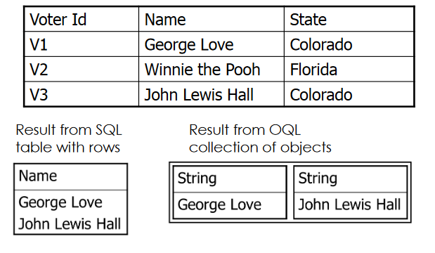
Oql example
Example: OQL query to obtain Voter names who are from the state of Colorado
Select distinct v.name
From voters v
Where v.state = “Colorado”

Slide 9
Oql examples
Create objects as in OO Languages and then make them persistent using the set() method on the database or store
Person p1 = new Person(“Pikes Peak”,78);
db.set(p1);
Retrieve by age (null default for string)
Person p = newPerson (null, 35);
ObjectSet<Person> result = db.get(p);

Slide 10
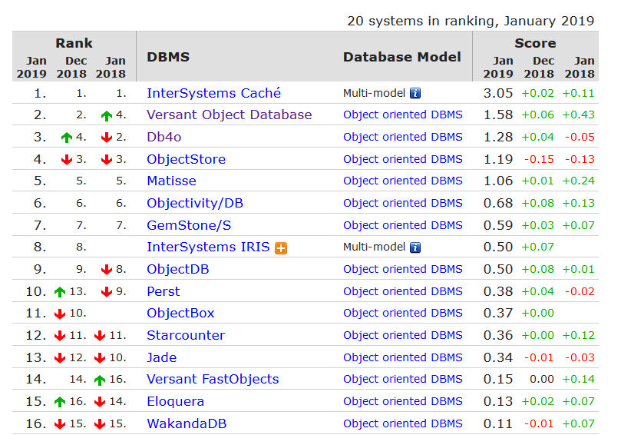
ODBs ranking
https://db-engines.com/en/ranking/object+oriented+dbms

Slide 11
for each(Example)- for( : )
https://www.aprenderaprogramar.com/index.php?option=com_content&view=article&id=632:el-for-extendido-o-bucles-for-each-en-java-ventajas-e-inconvenientes-ejercicio-ejemplo-resuelto-cu00666b&catid=68&Itemid=188
https://javadesdecero.es/arrays/bucle-for-each/
We can use for in the following way:
int[ ] listOfNumbers={3,2,4,5,7,6};
for(int n: listOfNumbers){
System.out.println(n);
}
The only symbol inside the for is :
n is the name of the local variable that will take the value of the objects in the array, list, arrayList, collection, etc.
Not recommended if you want to modify the array

Slide 12
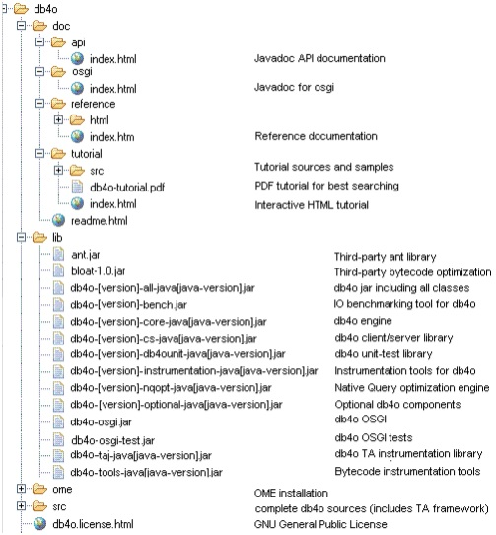
PRACTICE 4-2. Db40:

